Slide 1
A Question and Answer TeleMed Session: Care, Treatment, and Upliftment, the Impact of the Corona Virus: Vaccines, Vaccine Hesitancy, Pregnancy and Vaccines, The Variants, the Impact on PLWHA, Children and the Vaccines. (26th session)
Information for a rapidly changing pandemic
Provided by Gospel Against AIDS © 2020

Slide 2
Theodore B. Jones, M.D. Director , Maternal Fetal Medicine Beaumont Hospital, Dearborn Division of Maternal Fetal Medicine Beaumont Hospital Royal Oak, MI
THEODORE B. JONES, MD
Theodore Jones, M.D., F.A.C.O.G., is the Director of Maternal Fetal Medicine and Associate Program Director of Obstetrics and Gynecology Education at Beaumont Hospital, Dearborn. In 2017, he joined the Divisions of Maternal Fetal Medicine and Fetal Imaging at Beaumont Hospital, Royal Oak. He remains as an Associate Professor, full time affiliate with Wayne State University School of Medicine where he had been on the faculty prior to joining Beaumont for 27 years.
Dr. Jones, a graduate of Morehouse College, received his medical degree from Temple University School of Medicine. He completed his Obstetrics and Gynecology residency at Baylor University Medical Center. He was a National Health Service Corp scholar and served three years in rural Arkansas to satisfy his commitment. He completed his fellowship in Maternal Fetal Medicine at Wayne State University/Hutzel Hospital. He is a fellow of the American College of Obstetricians and Gynecologists and is a Diplomate of the American Board of Obstetrics and Gynecology, for which he is also a subspecialty board examiner. He served as a member of the full-time faculty at the School of Medicine 1991-2018. He has served as program director, associate chair for Education and, most recently, interim chair of the WSU Department of Obstetrics and Gynecology from 2007-2010. He has been division chief for Maternal-Fetal Medicine and chief of Obstetrics for Hutzel Women’s Hospital.
The founding medical director of the Perinatal Infectious Disease Clinic at the University Health Clinic, Dr. Jones served as the primary obstetric investigator for perinatal trials sponsored by the International Maternal Pediatric Adolescent AIDS Clinical Trials Group sponsored by the Eunice Shriver National Institute for Childhood Diseases and Human Development for two decades. In addition to serving as a subspecialty board examiner for ABOG, he is a member of the Board of Directors for the Michigan State Medical Society and serves as Speaker of the House for their House of Delegates and remains an active member of the Wayne County Medical Society where he served as their 133rd President. He is on the board of directors for Gospel Against AIDS, a faith-based organization working to educate about and eliminate HIV infection from southeast Michigan.

Slide 3
Peter Gulick, M.D. Professor College of Osteopathic Medicine Michigan State University
Peter Gulick, DO, FACP, FACOI, FIDSA.is Board certified in Internal Medicine, Medical Oncology, and Infectious Diseases and has cared for HIV patients for over 30 years. He has also taken care of Hepatitis C patients for 20 years. Dr. Gulickl is a professor at the Michigan State University College of Osteopathic Medicine, and developed courses in HIV and Hepatitis. He teaches medicine residents as well as ID fellows on HIV and Hepatitis C at his clinical sites.
Dr. Gulick is currently the Director of HIV/Hepatitis clinics at three sites; Ingham County Health Department, Central Michigan Department of Community Health, and Great Lakes Community Health Clinic. All three sites are FQHC sponsored clinics, and all are funded by Ryan White for HIV Care. I am currently taking care of over 1000 HIV patients and over 500 Hepatitis C and B patients.
He is the Director of the HIV Registry at Michigan State University. The registry has data on over 600 HIV patients. The registry is currently doing translational research at MSU, which has and is sponsored by NIH. Dr. Gulick serves as Associate Professors for Department of Internal Medicine College of Osteopathic Medicine Michigan State University and Associate Professor, Department of Medicine College of Human Medicine also at Michigan State University.
Dr. Gulick has served as the Program Director at Sparrow Hospital Internal Medicine combined residency program Colleges of Human Medicine and Osteopathic Medicine and Thread Director Infectious Disease curriculum development for the College of Osteopathic Medicine. Dr. Gulick has taught faculty at the Colleges of Osteopathic Medicine, Human Medicine, Nursing lecturing on ID, hematology and Oncology Statewide Campus System Didactic training for Residents r/t infectious Diseases.
Dr. Gulick is a member of the American Osteopathic Association, the American Liver Foundation, the American Medical Association, the Society for Microbiology, He has served as a member of the International AIDS Society, the International Immunocompromised Host Society, the Infectious Disease Society of America-Fellow, the Division Chair for the Microbiology-Immunology National Board of Medical Examiners, Julian Samora Research Institute at Michigan State University. To name a few.
Dr. Gulick attended Mount Union College in Alliance, Ohio where he received his B.S. in Chemistry/Biology and received Honors – Physiology Award. He attended Medical School at Chicago College of Osteopathic Medicine with a degree in D.O. Receiving honors as being among the top 10% of honored graduates.

Slide 4
Misinformation
46% of the 10,000-top posts for or against vaccines came from 50 Facebook pages.
There is a micro-chip in the vaccine that tracks our every move.
The vaccine is poison.
More people have died or gotten critically ill from the vaccine than the media. Reports.
People who have taken the vaccine have become sicker than they would have if they had contracted COVID 19.
The vaccines were created too quickly to be effective.
Vaccine creation is a conspiracy to rid the population of certain people.
If you are politically correct, you should not take the any of the vaccines.
“I will take my chances.”
The Chinese created both the virus and the vaccines.

Slide 5
Fully Vaccinated. With the Delta variant things have and continue to change
This next slide showed what we “could” do fully vaccinated in April 2021
Now, these CDC suggestions have change.

Slide 8
Mandates Lifted - Standard Procedures That are Still in Place
Many retail stores and supermarkets still encourage but do not mandate mask wearing before entry.
Doctors’ offices and hospitals: masks are required.
Patients are asked to wait in their car to receive a text message to enter at the time the physician is ready to see them
Social distancing in waiting rooms: decreased capacity
Visits to the hospital or to drop off a loved one.
One visitor for patient
ER: no visitors

Slide 9
How have Surgical Procedures Changed ?
Elective (non-emergency) surgery has begun to be cancelled in communities with where COVID hospitalizations are high
Develop a dedicated COVID-19 operating room (lower disease spread)
Assign roles to surgical team to limit exposure if patient is COVID-19 pos
Consider using a negative pressure room when available
Maximize protection during start of general anesthesia to minimize aerosolized particles

Slide 12
Pregnancy COVID 19 Vaccinations and HIV
What we learned about mother’s who delivered babies after receiving a COVID 19 vaccination
Vaccine side effects
For the baby
For the mother
Prenatal treatment for COVID 19 and HIV infected mothers
What if you are HIV positive and have contracted COVID 19?
Course of treatment

Slide 13
How we now care for pregnant mothers (COVID)
Caring for pregnant mothers who have COVID 19 (HIV)
Risk of heightened risk of miscarrages
What we advise visitors in labor and delivery
If someone in the home has tested positive for COVID 19 what should the mother/parents do?

Slide 14
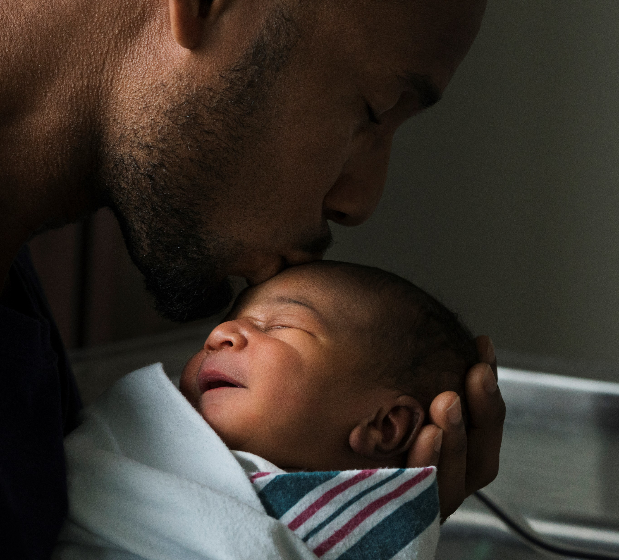
COVID 19 and Miracles Births
Miracles
Mothers with HIV and COVID 19
Newborns whose mothers were vaccinated or whose mothers’ contracted COVID 19, show COVID antibodies.
Transmission of COVID 19 to infants
Death rates

Slide 15
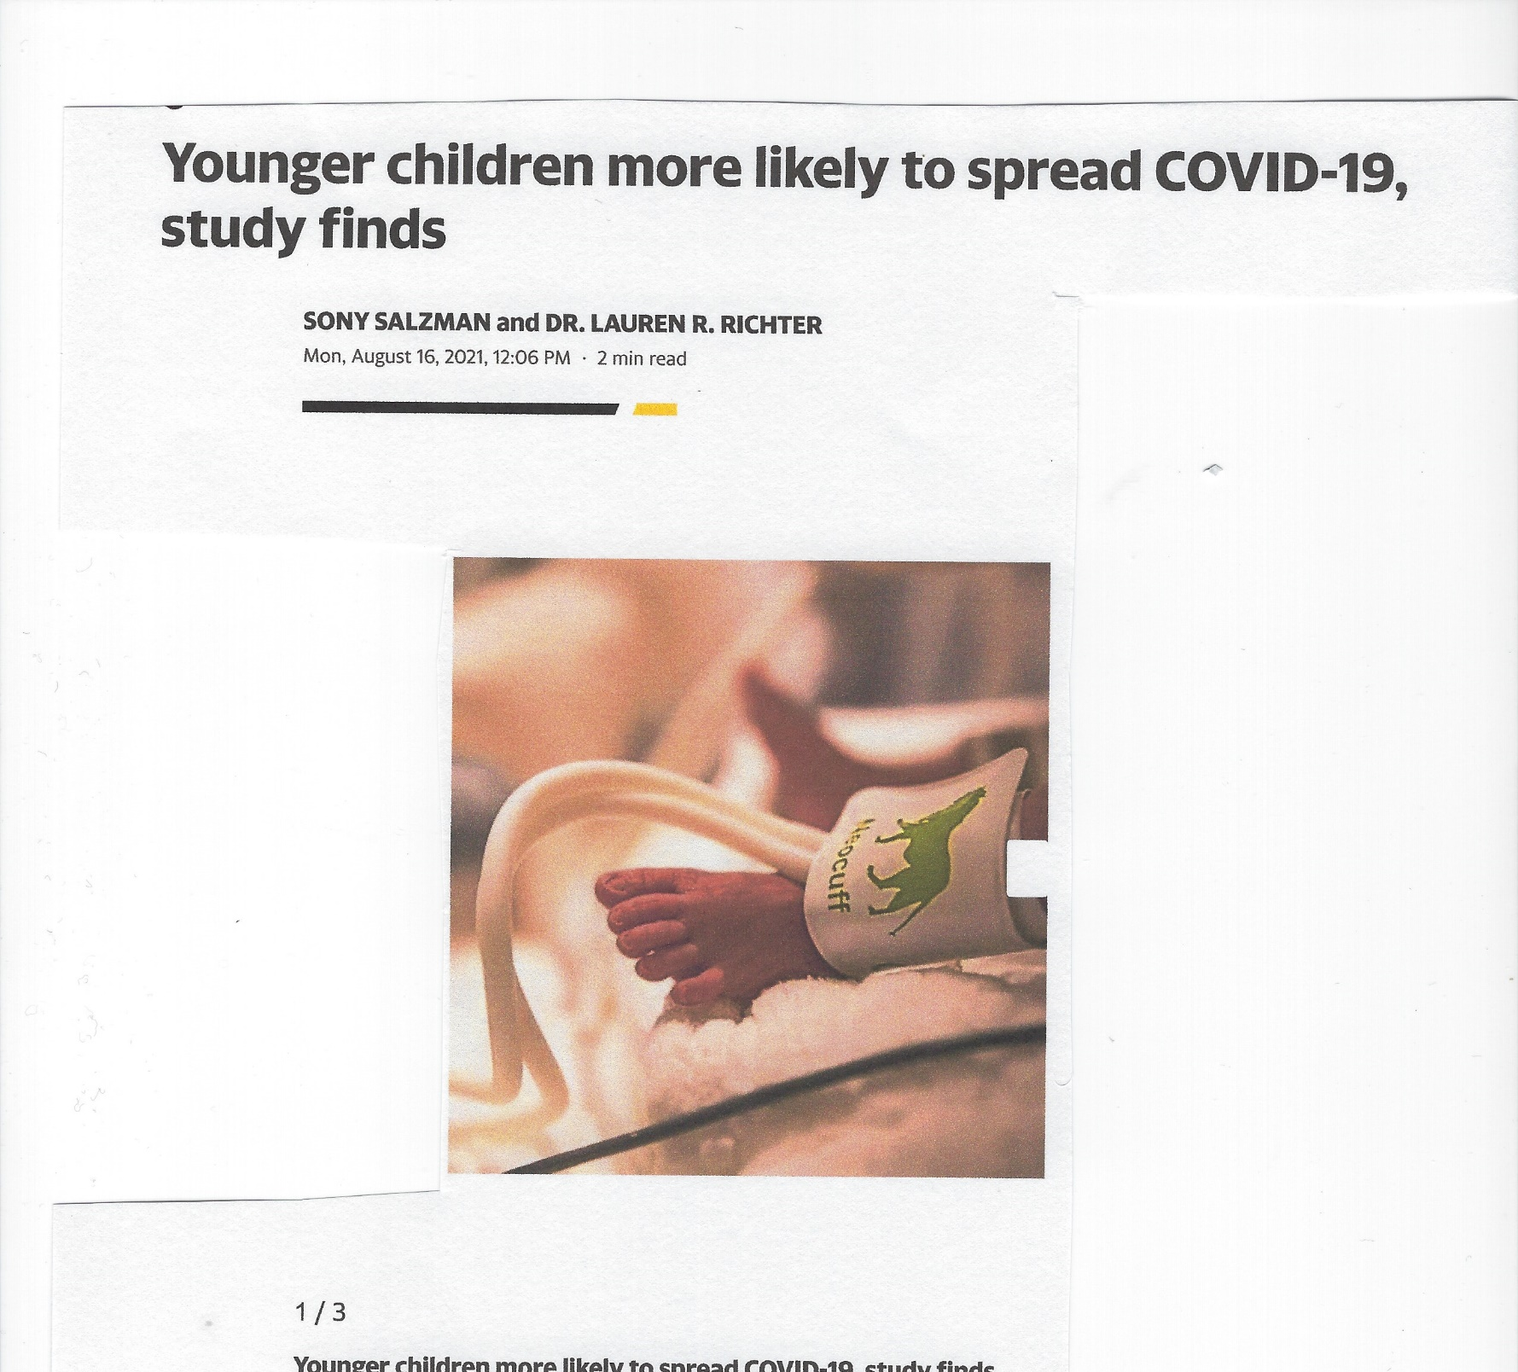
Children and the Spread of the Virus

Slide 16
Vaccine Hesitancy Among Health Care Workers – Your Encounters
Autonomy and personal freedom
Distrust of government
and health organizations
Safety and efficacy concerns
Prefer physiological immunity

Slide 17
Front Line Health Workers and Fatigue

Slide 18
Peter Gulick, M.D. Professor College of Osteopathic Medicine Michigan State University
Peter Gulick, DO, FACP, FACOI, FIDSA.is Board certified in Internal Medicine, Medical Oncology, and Infectious Diseases and has cared for HIV patients for over 30 years. He has also taken care of Hepatitis C patients for 20 years. Dr. Gulickl is a professor at the Michigan State University College of Osteopathic Medicine, and developed courses in HIV and Hepatitis. He teaches medicine residents as well as ID fellows on HIV and Hepatitis C at his clinical sites.
Dr. Gulick is currently the Director of HIV/Hepatitis clinics at three sites; Ingham County Health Department, Central Michigan Department of Community Health, and Great Lakes Community Health Clinic. All three sites are FQHC sponsored clinics, and all are funded by Ryan White for HIV Care. I am currently taking care of over 1000 HIV patients and over 500 Hepatitis C and B patients.
He is the Director of the HIV Registry at Michigan State University. The registry has data on over 600 HIV patients. The registry is currently doing translational research at MSU, which has and is sponsored by NIH. Dr. Gulick serves as Associate Professors for Department of Internal Medicine College of Osteopathic Medicine Michigan State University and Associate Professor, Department of Medicine College of Human Medicine also at Michigan State University.
Dr. Gulick has served as the Program Director at Sparrow Hospital Internal Medicine combined residency program Colleges of Human Medicine and Osteopathic Medicine and Thread Director Infectious Disease curriculum development for the College of Osteopathic Medicine. Dr. Gulick has taught faculty at the Colleges of Osteopathic Medicine, Human Medicine, Nursing lecturing on ID, hematology and Oncology Statewide Campus System Didactic training for Residents r/t infectious Diseases.
Dr. Gulick is a member of the American Osteopathic Association, the American Liver Foundation, the American Medical Association, the Society for Microbiology, He has served as a member of the International AIDS Society, the International Immunocompromised Host Society, the Infectious Disease Society of America-Fellow, the Division Chair for the Microbiology-Immunology National Board of Medical Examiners, Julian Samora Research Institute at Michigan State University. To name a few.
Dr. Gulick attended Mount Union College in Alliance, Ohio where he received his B.S. in Chemistry/Biology and received Honors – Physiology Award. He attended Medical School at Chicago College of Osteopathic Medicine with a degree in D.O. Receiving honors as being among the top 10% of honored graduates.

Slide 19
COVID-19 Update
Delta Variant
Majority of cases in USA 94%
Much more transmissible
May be more virulent?
Vaccine may not be as effective in prevention but still effective in hospitalization and death
Monoclonal antibodies may not be as effective

Slide 20
COVID-19 Update
Breakthrough Infections
Definition is getting COVID-19 despite vaccination
Seen more with Delta
Incidence 10,000 patients with breakthrough out of more than 100 million people
Severity
Many are asymptomatic 25-30%
Mild symptoms 50-60%
Severe with hospitalization 10%
1-2% die
Efficacy depends on individual
Immunocompromised higher risk
May need booster dose

Slide 21
COVID-19 Update
Unvaccinated
Majority of hospitalizations are unvaccinated
Most are young
Death rate still low
New and more serious variants will continue to emerge as long as there are unvaccinated
Post COVID Syndrome is serious
Long-lasting condition
Even mild infections can lead to this

Slide 22
COVID-19 Update
Immunity
Involves short-term bNAb
Involves long-term memory B cells and T cells
Natural immunity vs. vaccine immunity
Need 2 doses of vaccine for optimal protection especially with variants
Natural immunity alone not effective for variants
Natural immunity plus single dose vaccine has high levels bNAb
Question about how memory B cells and T cells will affect long- term protection

Slide 23
COVID-19 Update
Vaccinations
Types:
MRNA
Still may be the best test overall
Adenovirus vectors
Johnson & Johnson single dose
May not be as effective for variants

Slide 24
COVID-19 Update
Side Effects:
Overall very low
No red flags
Indications:
Everyone
Pregnancy
Immunocompromised
Boosters:
Immunocompromised
Others?

Slide 25
COVID-19 Update
COVID-19 and Children < 12 Years Old
No vaccine yet
Higher amount of children infected with variant
4.8-17.6% of children tested were positive
1.5-3.5% hospitalized
0.00%-0.26% deaths
Symptoms
Multisystem inflammatory syndrome
May get long hauler's condition
Protect children especially home and school
Masking and social distancing
Frequent testing
Vaccinating adults at home and school

Slide 26
Child/Adolescent COVID-19
General Facts
In Sept-Oct 2020 children represented 10% of cases
In April 2021 children represent 22%
3,854,791 cumulative confirmed cases
72,000 new cases 1st week of May

Slide 27
COVID-19 Children and Adolescents
Special Issues
Vaccine mandates
Schools handling masking in classrooms
How schools address diagnostic testing especially if vaccinated
Vaccines in those already infected
Asymptomatic have low titers
How to handle respiratory virus, flu, RSV in fall
How variants (484) influence this

Slide 28
COVID-19 in Children and Adolescents
Vaccine (12-15 years)
Pfizer is approved
General data on study (N=1131)
Ages 12-15
Female 49.9%
Mean age 13.6
Median age 14
Ethnicity
Black 4.6%
Hispanic 11.7%
Comorbidity 21.9%

Slide 29
Vaccine Recipients Long Term Survivors Questions

